Slide 1

Airbnb Housing Price Prediction
Shakil Amin*908089
Ca’ Foscari University of Venice
Date: June 2025
Advising Professor : Marcello Pelillo
Foundations of Machine Learning
a.y. 2024/25

Slide 2
Introduction
Importance of accurate Airbnb price prediction
Benefits for hosts (competitive pricing) and guests (value alignment)
Project objective: Predict listing prices using multiple features and machine learning

Slide 3
Workflow
Merge Data > Exploritory Data Analysis > Data Prepocessing > Modeling

Slide 4
Dataset Overview
Data sourced from multiple cities and day types (weekdays/weekends)
Number of listings: 50,000+
Key variables: price, room type, city, cleanliness, guest satisfaction, distances, host info

Slide 5
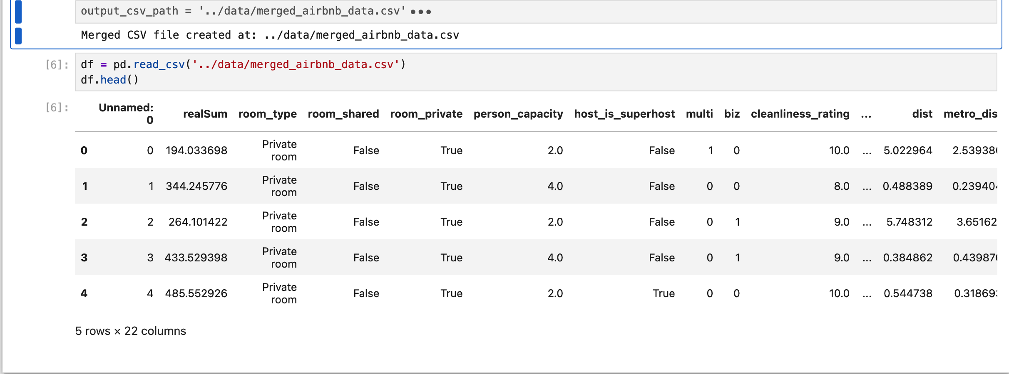
Data Merging Process
Extracted multiple CSVs from ZIP archive
Added city and day_type columns based on filenames
Merged into one comprehensive dataset
Sorted and saved for analysis

Slide 6
Exploratory Data Analysis (EDA) — Data Quality
Checked for missing values and duplicates.
Data types and distribution overview.
Found minimal missing data, removed duplicates.

Slide 7
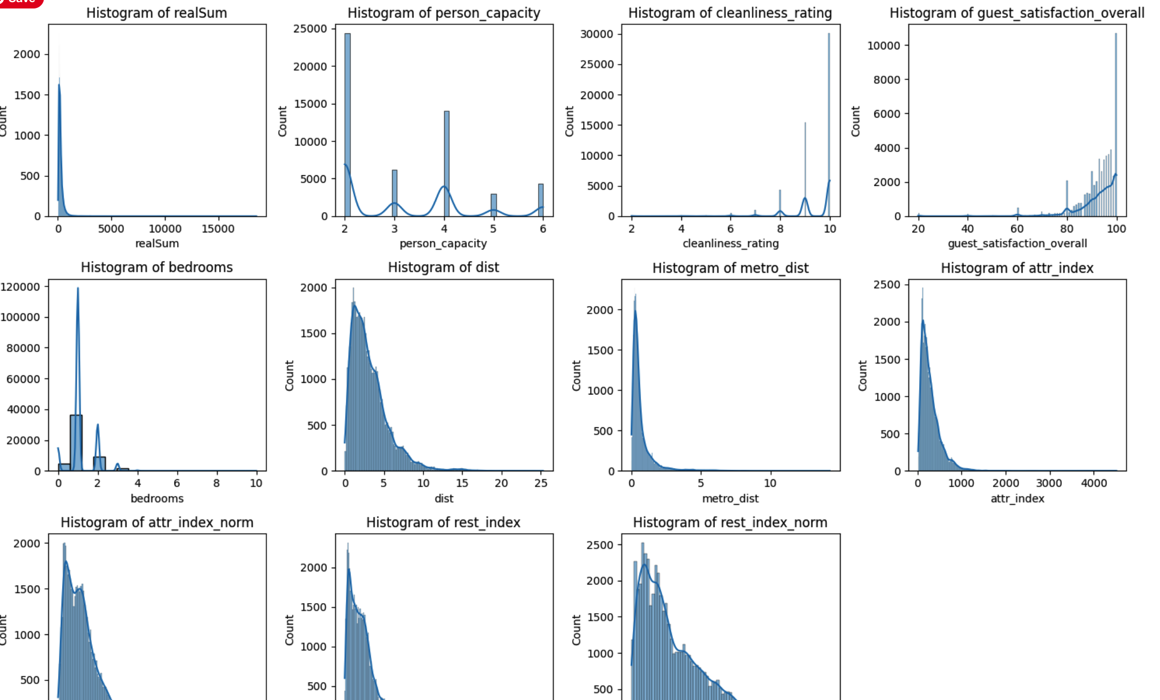
Numerical Feature Distributions
Histograms with KDE for price, cleanliness, capacity, distances.
Observed skewness in price and some features

Slide 8
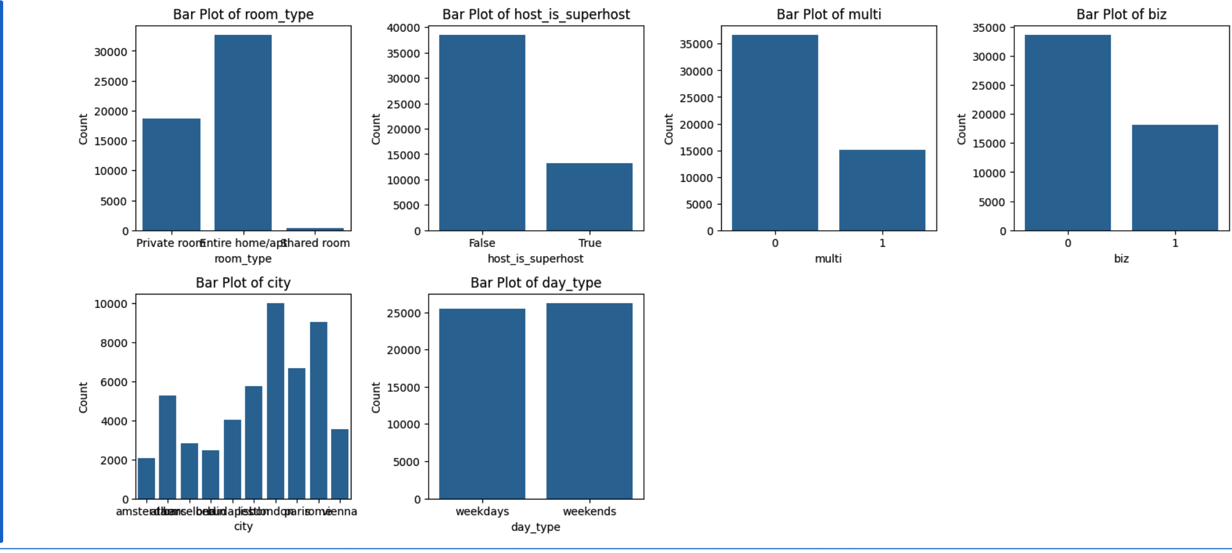
Categorical Feature Distributions
Bar plots for room type, host superhost status, city, day type
Most listings are entire homes or private rooms
Superhosts represent significant portion

Slide 9
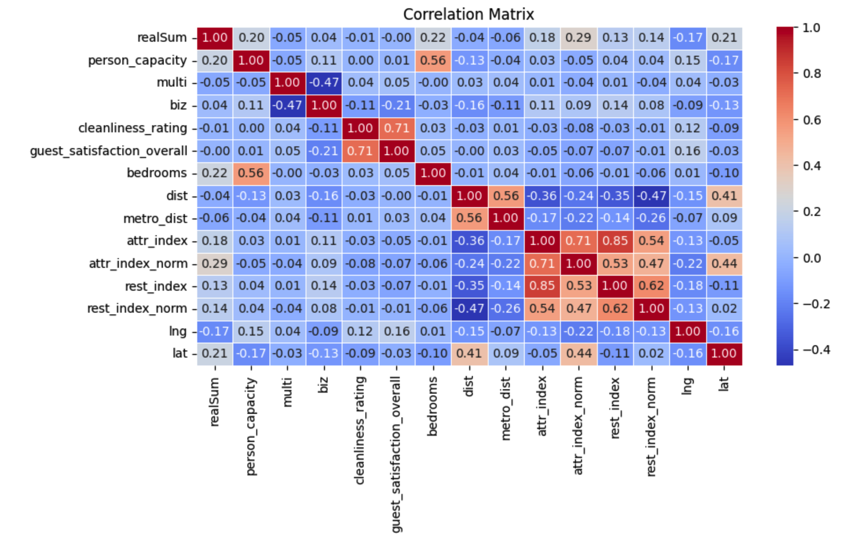
Correlation Heatmap
Correlation matrix of numerical features
Strong correlations between bedrooms and capacity, price and guest satisfaction

Slide 10
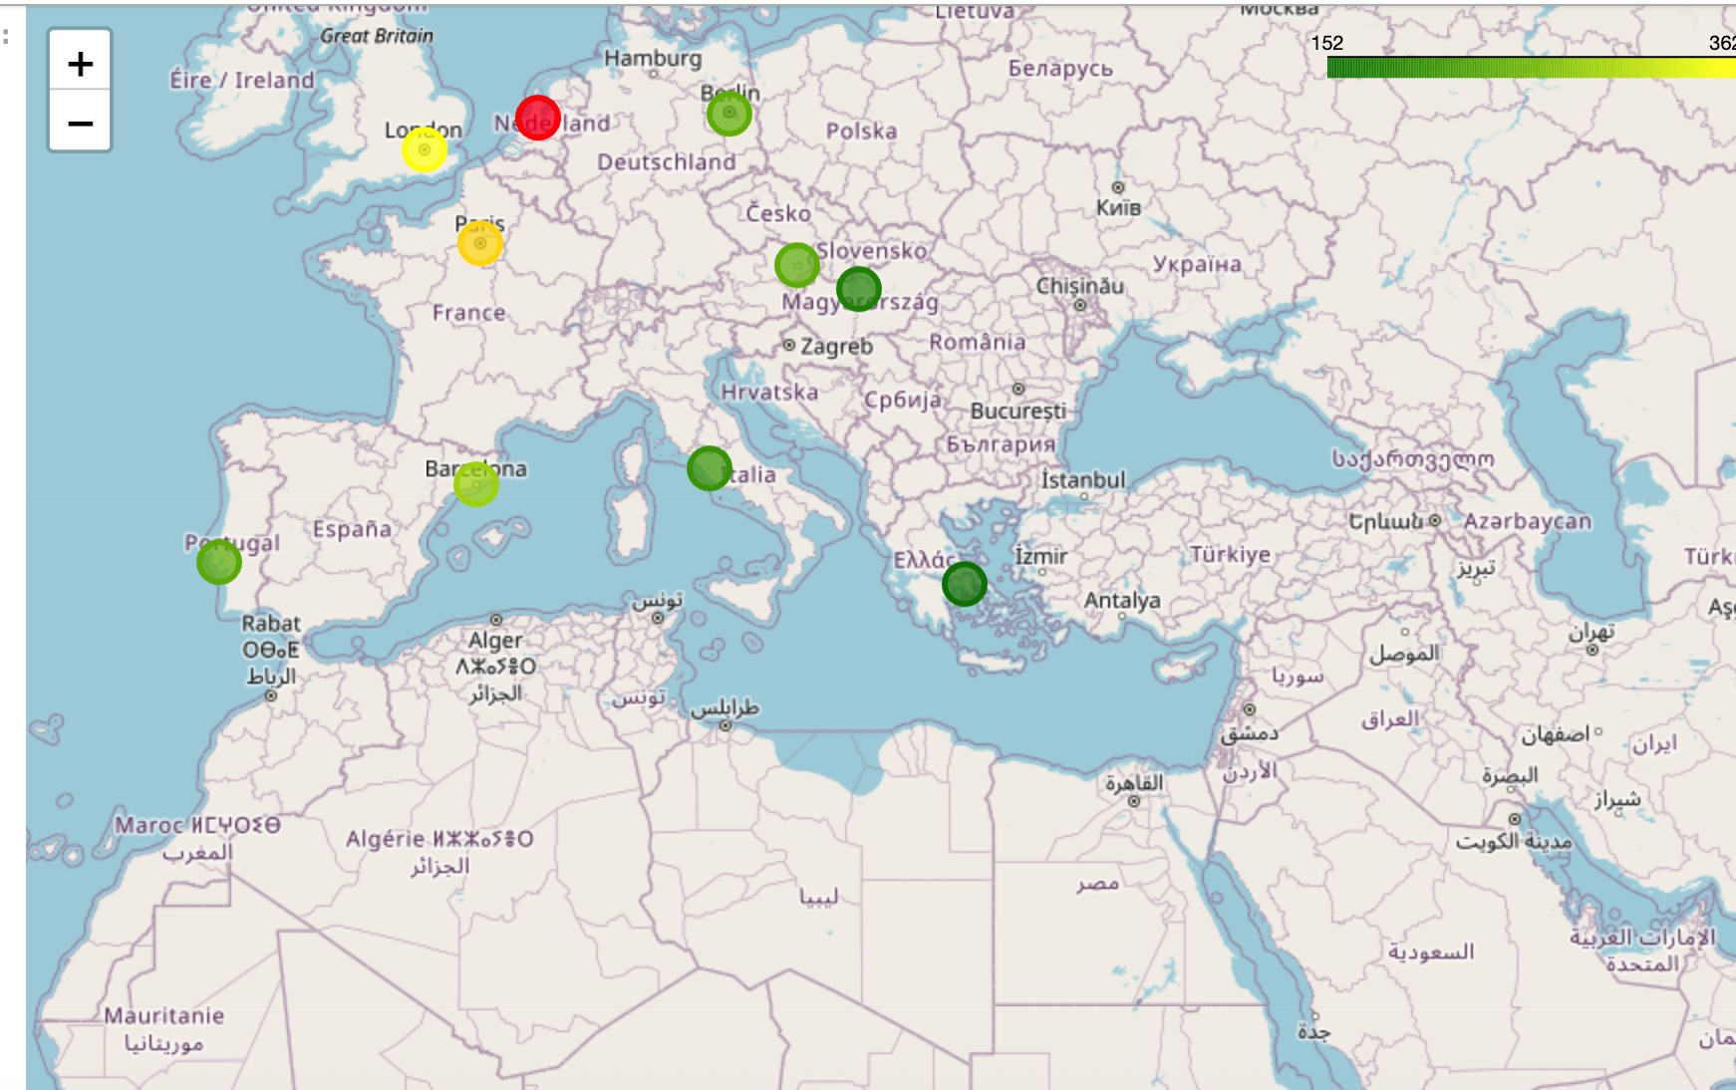
Geospatial Visualization
Folium maps showing listing density and average prices by city
Heatmaps reveal hotspots near city centers and metro stations
From. R. E. Turner

Slide 11
Data Prepocessing
Feature Engineering
Created space_index = bedrooms × person capacity
Created metro_to_city_dist_ratio = metro_dist / dist
Dropped redundant columns (raw coordinates, duplicated features)

Slide 12
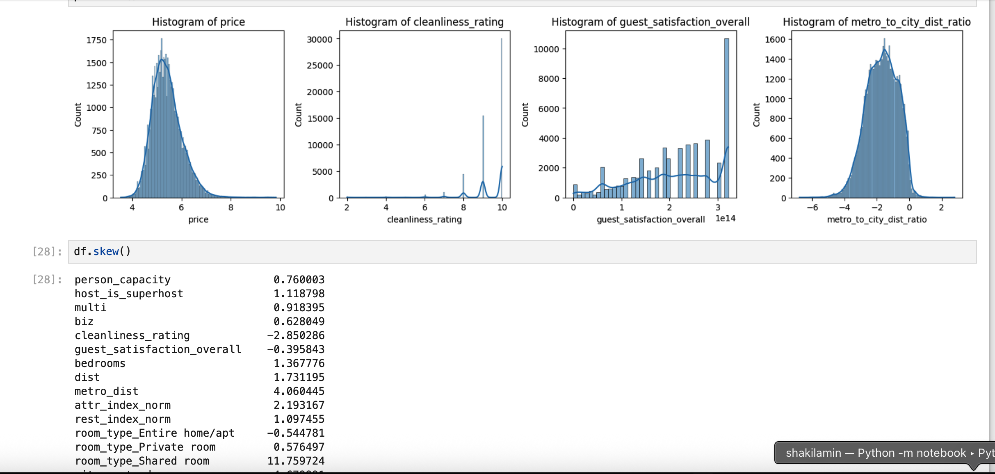
Handling Skewness and Outliers
Identified skewness in price and other features
Applied log transformation to price and metro-to-city ratio
Applied Box-Cox transformation to guest satisfaction
Detected outliers using IQR method

Slide 13
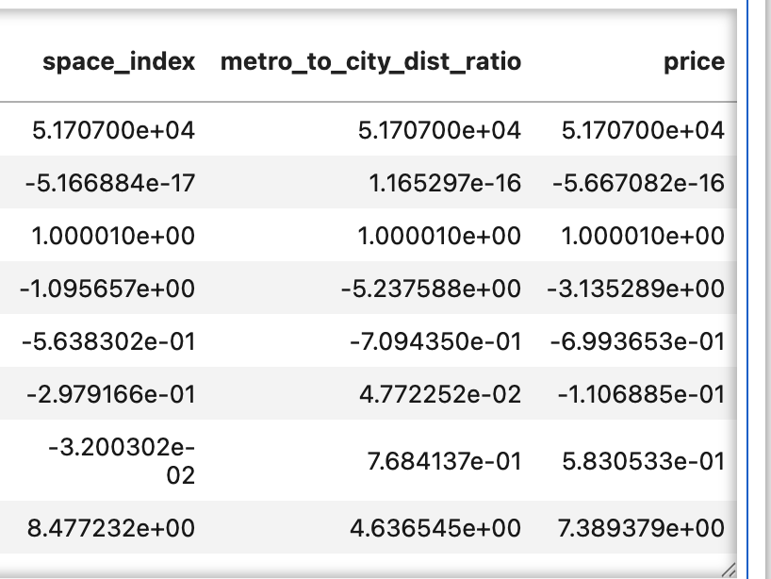
Feature Scaling
StandardScaler for price, metro-to-city ratio, space_index
MinMaxScaler for cleanliness and guest satisfaction
RobustScaler for attraction and restaurant indices

Slide 14
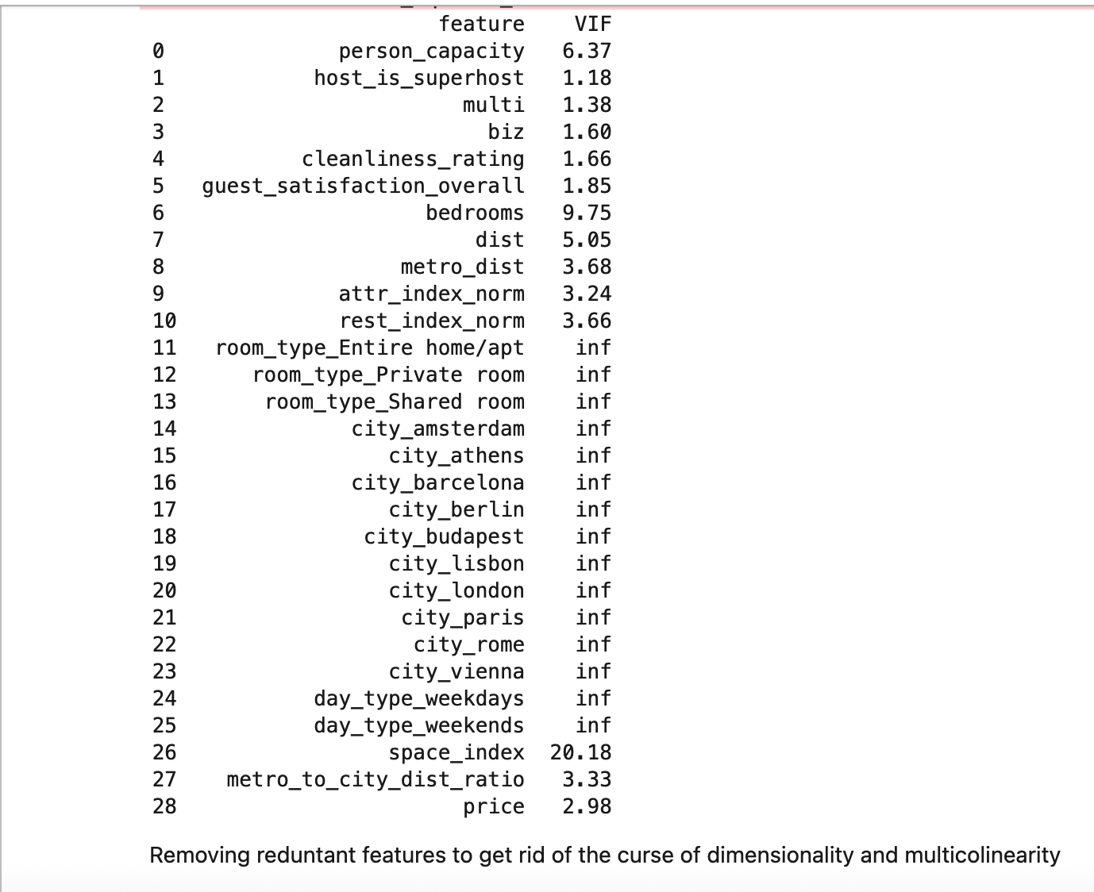
Multicollinearity Check
Used Variance Inflation Factor (VIF) to detect multicollinearity
Combined bedrooms and capacity into space_index
Dropped original correlated columns to improve model stability

Slide 15
Modelling
1. Splitting the Data into Training and Test Sets
2. Hyperparameter Tuning : Models, hyperparameters and loss function
3. Evaluation of Models on the Test Data
4. Retraining the Best Model on the complete training set for prediction.
5. Interpretation of Results

Slide 16
Data Spliting into Train and Test Sets.
It is good practice to split the data into training, validation and test sets. Validation set is useful for hyperparameter tuning and model selection. Therefore, during hyperparameter tuning, we apply K fold cross validation. It is important to keep the test set completely independent to make sure that the model does not overfit and that there is no data leakage between the train and test set.
80:20 split for training and test set is an accepted split to use, since it provides enough data for cross validation based hyperparameter tuning and test set, as we have a large amount of data (50,000 + data samples).

Slide 17
Models Evaluated
Linear Regression, Ridge, Lasso
Polynomial Regression
Decision Tree, Random Forest
XGBoost
Support Vector Regression (SVR)

Slide 18
Hyperparameter Tuning
Used GridSearchCV and RandomizedSearchCV with 5-fold cross-validation
Optimized parameters like alpha, max_depth, learning_rate, n_estimators

Slide 19
Evaluating Models on the Test Set
For each model, grid_search is executed, which stores the following information:
grid_search.best_params_: a dictionary containing the hyperparameters that resulted in the best performance according to the specified scoring metric i.e. MAE.
grid_search.best_score_ : This attribute gives the best score achieved by the model using the best hyperparameters found during the grid search.
grid_search.best_estimator_: provides the actual model (estimator) instance that was trained with the best hyperparameters.

Slide 20
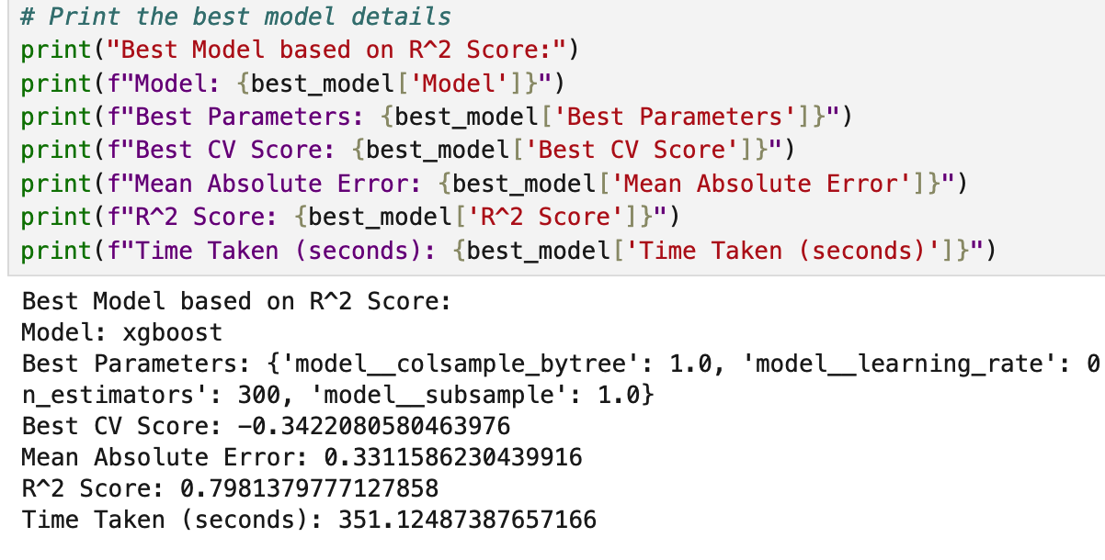
Best Model Evaluation
Best Model will be the one with the lowest Mean Absolute Error. R2 scores can be used for comparison as well.

Slide 21
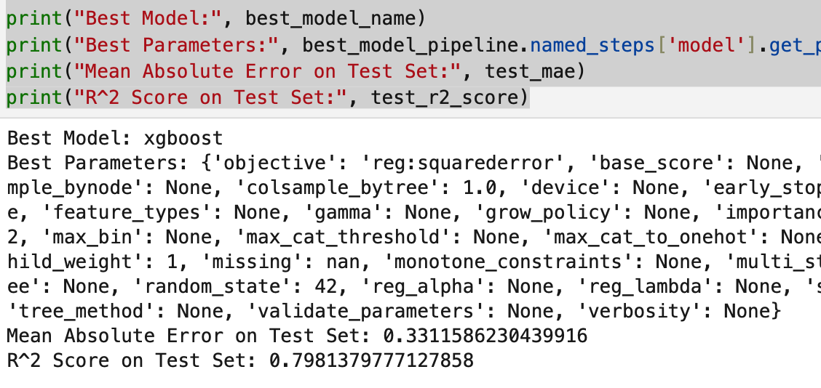
Retraining the best model again
Once the best model with its optimal hyperparameters using cross-validation on a training set are identified, it's beneficial (and a best practice) to train the model on all available training data to potentially improve its performance - thereby improving generalization. This is usually possible, when the retraining is not computationally expensive.
There is not much improvement in the result, but can sometimes lead to better generalization ability of the model.

Slide 22
Interpretation of Result
Actual vs Predicted Values
The x-axis represents the actual values (ground truth) from the test set (y_test), and the y-axis represents the predicted values (test_predictions).
Each point in the scatter plot represents a data point from the test set, where the x-coordinate is the actual value, and the y-coordinate is the predicted value.
The dashed line represents the line where actual values equal predicted values (perfect prediction). Points close to this line indicate accurate predictions.
The blue dots represent the actual vs. predicted values. We plot the perfect prediction line for comparison.

Slide 23
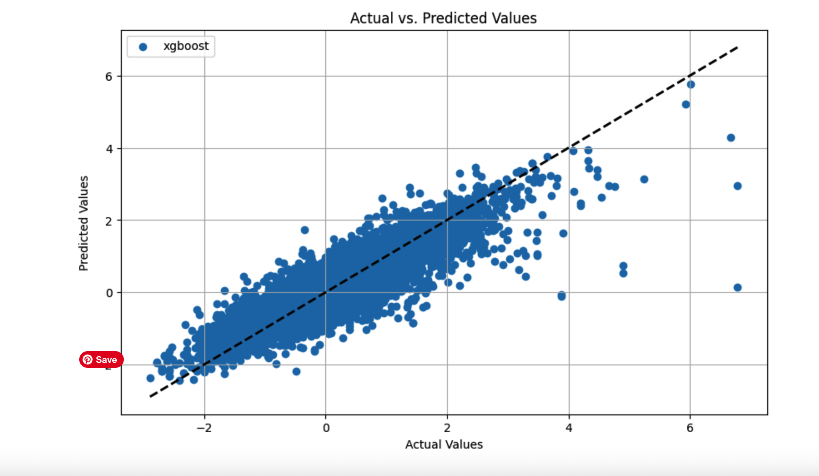

Slide 24
Conclusions and Future Work
XGBoost is the best-performing model for Airbnb price prediction
Future improvements:
Incorporate seasonality and event data
Explore ensemble and neural network models
Deploy real-time pricing recommendation system

